Slide 1
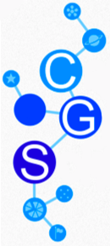
Center for Game Science
Over 35 PhD, ugrads, SDEs, desginers, artists
6 games currently in development

Slide 2
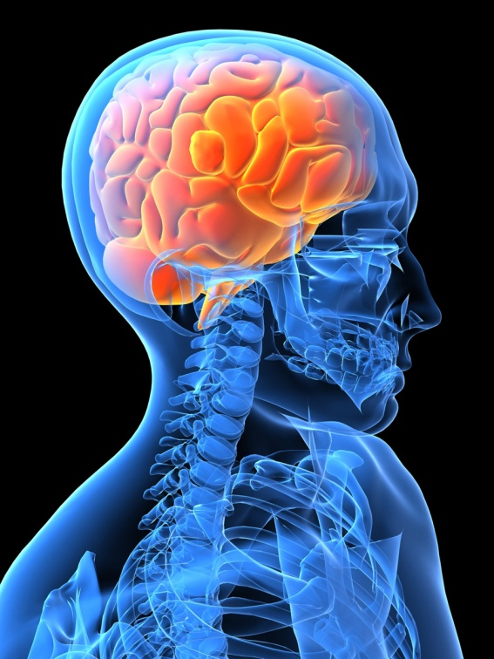

Symbiotic Human-Computer
Computing architecture
Notes:
This talk discusses a class of games with a purpose – scientific discovery games – and the unique challenges they present.
*** The purpose of scientific discovery games is enabling non-experts to advance a specific scientific domain and solve problems that neither humans nor computers could solve alone
These are games to solve hard problems, requiring players to stick around and develop expertise in an area.
In this talk I will discuss our experience with a scientific discovery game and seek to give insight into the following:

Slide 3
Solving Hard Problems with Human-Computer Symbiosis
Coadaptation:
People → Experts
Programs/Games → Optimal problem tools
Games are an ideal vehicle of coadaptation

Slide 4
Center for Game Science
Over 35 PhD, ugrads, SDEs, desginers, artists
6 games currently in development

Slide 5
The Challenge:
hard to make an entertaining game
even harder do it and solve a hard problem
constraints on game design
make real discovery, really learn something
Long term involvement
cannot separate the two objectives
Very different than standard game design
Notes:
hard to make entertaining game for money
even harder to do this and solve a problem
at least twice as hard
no leeway for game design if you need it to be real
really learn, real biochemistry
cannot separate the two objectives
need to combine game and science skill to discover how to do it
Infinitely harder,

Slide 6
Evidence?

Slide 7
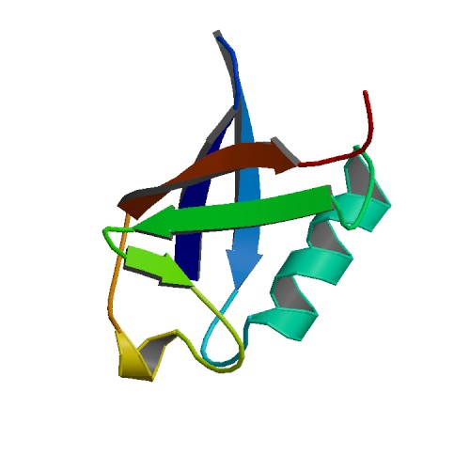
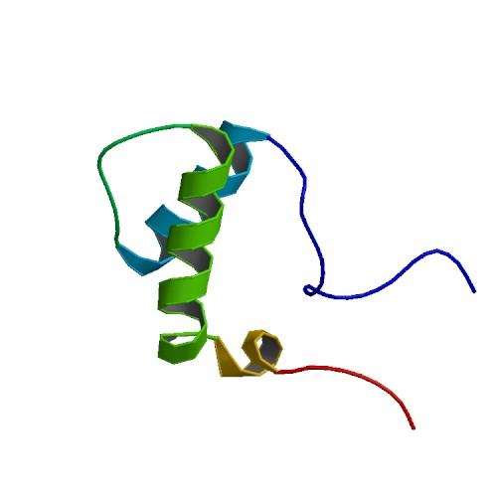
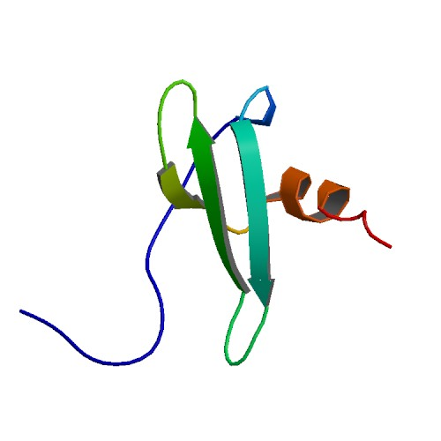
Proteins
MQIFVKTLTGKTILEVEPSDTIE…
MGKYDKQIDLSTVDLKKLRVKEL…
KPVSLSYRCPCRFFESHVARANV…
…
…
Sequence
3D Structure
Notes:
There are many sequences and structures.

Slide 8
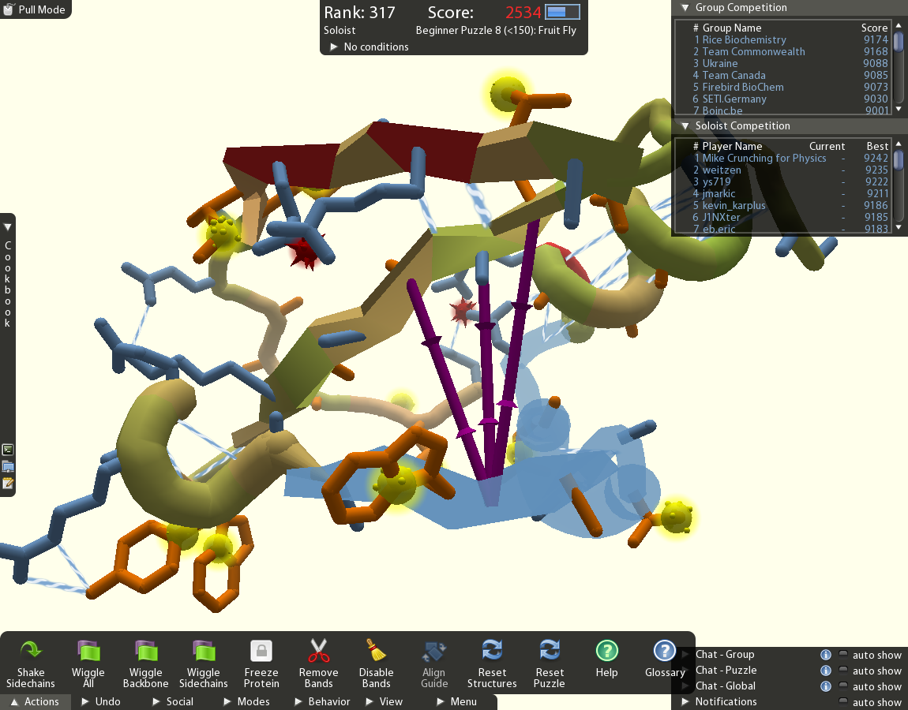
Foldit
Notes:
Look at how we approached these challenges with Foldit
Game to tackle key problem in biochemistry: protein structure prediction
Proteins do all functions in all living organisms: understanding protein folding = secret to life
Problem is to determine how a particular protein will fold
Joint project with UW biochemistry Baker Lab
Players and groups compete to find high scoring protein structures
Real-time scoring based on scientifically accurate protein energy model
So high scores -> better folded

Slide 9
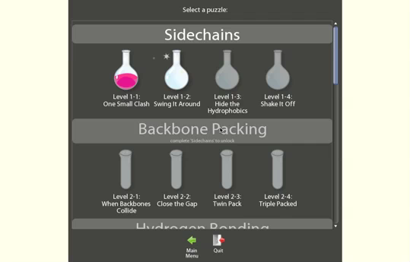
Training
Notes:
These are offline puzzles grouped by related concepts
They teach visualization and interactions, with set goal score
Context sensitive Text-bubble hints guide players to solution
Players are rewarded for success with fun animations

Slide 10
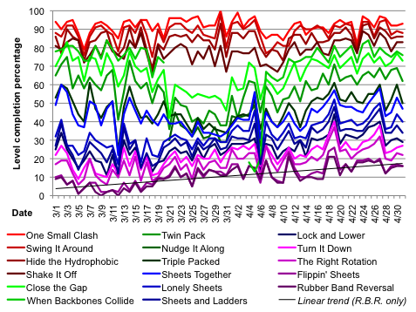
Training
refinement
Notes:
Level refined through think alouds and data gathering
Use data to find problems in levels and evaluate changes, leveraging the many new players who join each day
x axis is days and y axis is percentage of players who completed the level
Each line is a level

Slide 11
Training
refinement
Notes:
This top red line shows that around 90 percent of people complete the first level

Slide 12
Training
refinement
Notes:
And the bottom purple one shows less than 10% complete the final one

Slide 13
Training
refinement
Notes:
And this larger gap between blue lines indicates an unusually large drop in players completing second blue level

Slide 14
Training
refinement
Notes:
At this point in time, we added context sensitive text bubble guides but also removed a level,

Slide 15
Training
refinement
Notes:
and a very large a gap opened between the red and green levels

Slide 16
Training
refinement
Notes:
To fix this, we restored the removed level here

Slide 17
Training
refinement
Notes:
We found that the gap closed, and the overall upward trend of completing all levels remained, likely due to the help bubbles
We felt this was a successful series of changes

Slide 18
Game-developed experts
Verif. experts
Gamers
People

Slide 19
Biochemistry not just for experts…
Notes:
beating biochemists

Slide 20
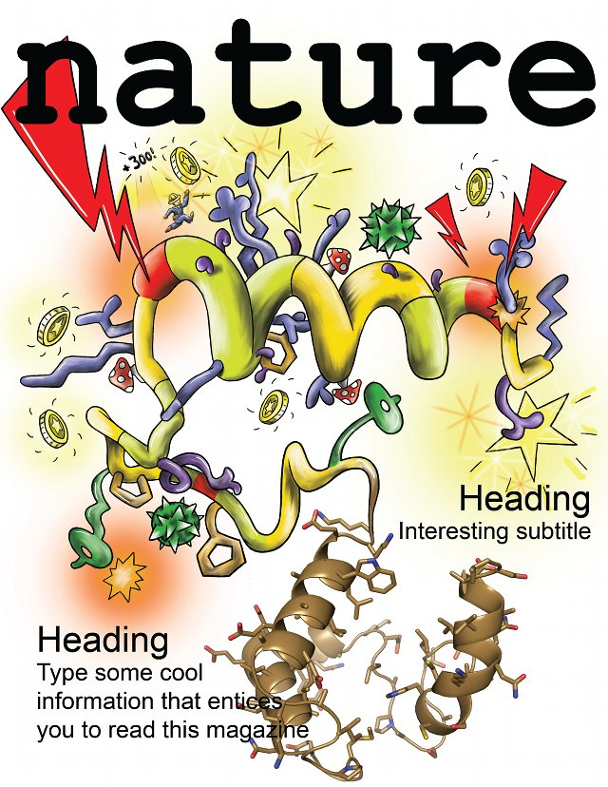

Slide 21
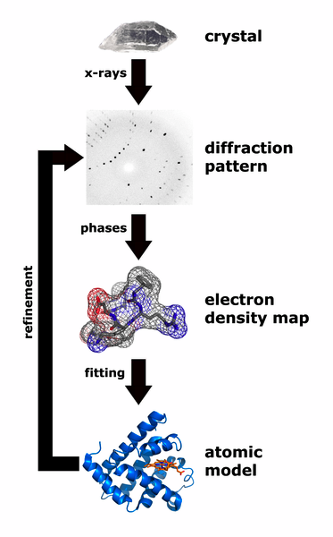
Experimental Structure Solved
Mason-Pfizer Monkey Virus Retroviral Protease (MPMV PR)
Plays a role in AIDS in monkeys
Experimentalists worked on for ~15 years
Computational methods failed to solve
Gave to players for 3 weeks
Notes:
Apply to real-world problem
Mason-Pfizer monkey virus (MPMV)
The most important problem solved by Foldit players to date came after CASP9 and involves the M-PMV retroviral protease. Retroviral proteases (PR) play a critical role in viral maturation and proliferation and are the focus of intensive anti-viral drug development work [8]. All previously determined crystal structures of retroviral proteases are in the active dimeric form [9]; the disruption of PR dimerization has been proposed as a mechanism for disruption of retroviral activity [10]. The retroviral protease of M-PMV, an AIDS-causing monkey virus, crystallizes as a monomer, but despite the availability of several crystal forms researchers for over a decade have been unable to solve the structure by molecular replacement (MR) using existing retropepsin models, including an NMR model of M-PMV PR [11]. A recent approach using density- and energy- guided structure refinement [7] was also unsuccessful at determining a solution, despite a success rate of over 50% in cases where similarly good homologous template structures were available. Of the unsolved cases presented in that paper, this was the only one suitable (non-oligimeric, and of small enough size) for use in Foldit.
In a final attempt to solve the structure of M-PMV PR, and to determine if human intuition could succeed where automated methods had failed, we challenged Foldit players to build accurate models of M-PMV PR starting from the NMR coordinates (which had failed in MR tests, Figure S3). When the three week competition concluded, we screened the top-scoring Foldit models using Phaser [12] to determine whether any were of sufficient quality for MR. Remarkably, despite the complete failure of all previous approaches, several solutions by the Foldit team Contenders produced phase estimates that were good enough to allow a rapid solution of the crystal structure.
We provided Foldit players with the ten different NMR models which all scored poorly using Rosetta’s energy function so that players would not be trapped in local energy minima, and included all ten NMR models as templates in the Alignment Tool. The improvement in model accuracy by the Foldit Contenders group is illustrated in Figure 2a. As game play progressed (x axis), model accuracy and suitability for MR, as assessed by the Phaser log-likelihood gain (LLG) (y axis) increased, with several notable jumps (arrows). Figure 2b-d illustrates some of the breakthrough models produced by Foldit players. Foldit player spvincent (yellow) used partial threading with the Alignment Tool and quickly improved the starting NMR model (red) to have much better agreement with the afterwards determined crystal structure (blue). Another teammate, grabhorn, was able to improve spvincent’s model (magenta), particularly in the core of the protein, and mimi was able to generate an even more accurate model (green) by correctly tucking in the loop at the top left. The LLG of this model was high enough to allow its unambiguous identification as a likely MR solution among the vast number of Foldit models and standard autobuilding and structure refinement methods showed within hours that the solution was almost certainly correct.
Using the Foldit solution, the final refined structure was completed a few days later. Of particular interest in this monomeric retropepsin structure is the molecular surface that normally forms the dimer interface in homodimeric protease molecules. There is a considerable backbone rearrangement in this area in which a flap curls over the half-active site in the monomer (Figure 3). Additionally, the N- and C-termini are totally disordered highlighting the absence of a dimerization interface. These features provide exciting opportunities for retroviral drug design, including anti HIV drugs; compounds that bind to the surface formed in the monomer but not the dimer should shift the equilibrium in favor of the former, which is catalytically inactive.

Slide 22
Useful field of view
Can low-level visual cognition be improved through game play?

Slide 23
Mech. Turk Incentive Optimization
$1 $0.5 $.03 $0.01 $0

Slide 26
Math Bottlenecks
Fractions
Algebra
Geometry
“Difficulty with fractions… is pervasive and is a major obstacle to further progress in mathematics.”
- US National Mathematics Advisory Panel final report, 2006, 2008

Slide 27
Repeated Gameplay Produces Consistent Improvement
4,000 3rd Graders
Three weekly level packs
Pretests integrated into gameplay
Notes:
Last fall we completed our first in-depth study of the effects of playing Refraction on student’s performance on tests, and we found that gameplay produced significant improvements. This study was conducted last with 4,000 third graders. It was a three week study, and every week the students received a new level pack with 20 levels touching on particular fraction concept. Each level pack included a pretest that was integrated into the game, and we also gave a final post-test at the end of the study.
What we found is that students’ scores on the pre- and post-tests made statistically significant improvements between each of the level packs, and the rate of improvement increased as the students played longer. These results are really encouraging, and they show that gameplay can improve player’s understanding of fractions.

Slide 28
Novice to Experts

Slide 29
In each case,
Data-driven evolution with large number of players is
1 to 3 times as long as initial development

Slide 30
Standard trickle down approach
Knowledge, Expert Principles
Novice or Student Tools
Outcomes
People

Slide 31
Incentivized Expert Creation
People
Incentive Structure
Discoveries, Education
Expertise, Knowledge

Slide 32
100
Secondary Award Effect
% of
players
0
Time

Slide 33
100
Secondary Awards Considered Harmful
% of
players
0
Time

Slide 34
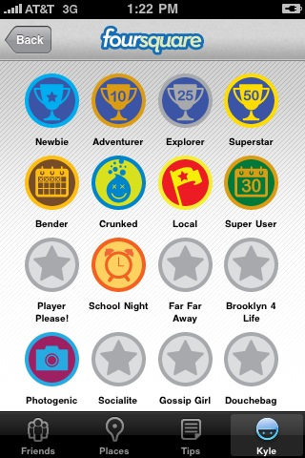
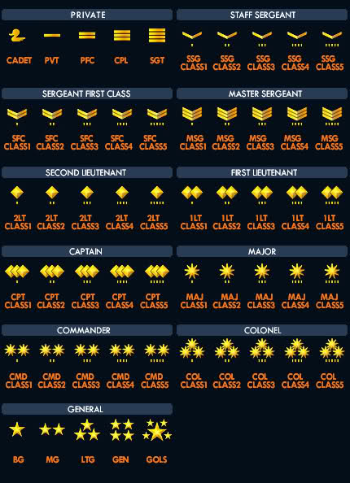
Extrinsic Motivation: short term effect

Slide 35
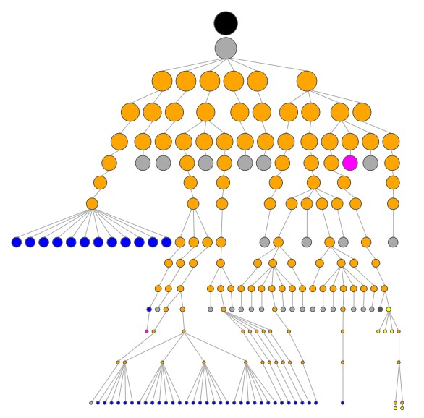
Hierarchical randomized trials

Slide 36
In-game assessment and intelligent tutor refinement
Notes:
There are many intelligent tutor instances out there. But how do we know if the specific tutor is optimal? Currently the answer is we don’t. We trust in the expert that designed it.
Our approach is to only trust data. Lots of data. Consider this current model of the game tutor.

Slide 37
100,000 players
100,000 players
100,000 players
Notes:
(please animate this slide)
We evolve the current tutor by presenting different variations to a number of different students, and assess the effectiveness of each. As long as the volume of students is large, and varied (we have 50,000 students from k12.com available for our studies) we can find the best variation.

Slide 38
Notes:
The process continues by varying the winner variation further, until we find the model that proves to be most effective.

Slide 39
Level Adaptation
Adapt to maximize long term engagement
Optimize for persistence
Expand at the boundary of understanding

Slide 40
Playtracer Query Tool
put_down_wrong_splitter(Action, Trace, Level, Player) :-
is_action(Action, Trace, Level, Player),
is_bad_splitter_on_board(Splitter, Level),
happens(Action, dropped_piece(Splitter)),
Uses logging data to generate facts (e.g., happens)
Leverages complex query language to encode game-specific logic in rules (e.g., is_bad_splitter_on_board)
Backed by database system that allows these queries to be run on a large amount data

Slide 41
Writing Rules
% holds if the user dropped a 2-splitter Piece on Action
did_drop_2splitter(Action, Piece) :-
happens(Action, drop(Piece, _)),
action(Action, Trace),
trace(Trace, _, Level),
holds(Level, piece_type(Piece, splitter2).
% action A2 happens after A1 in the same trace
% assumes next_action is correctly defined
later_action(A1, A2) :- next_action(A1, A2).
later_action(A1, A3) :-
next_action(A1, A2),
later_action(A2, A3).
% holds if the user dropped a 2-splitter Piece on A1
% but then picked it up later on A2
dropped_2splitter_then_picked_it_up(A1, A2, Piece) :-
did_drop_2splitter(A1, Piece),
happens(A2, pickup(Piece)),
later_action(A1, A2).

Slide 42
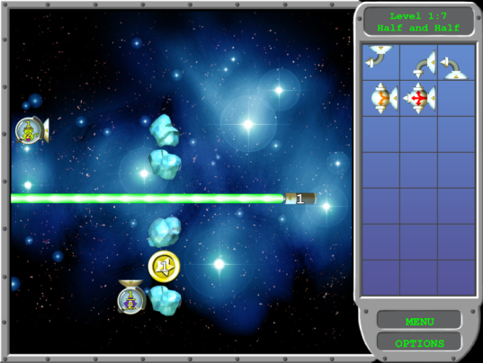
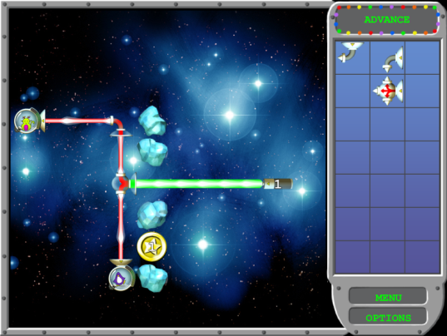
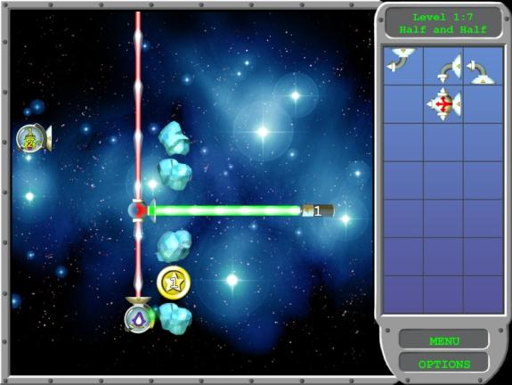
Start
Goal
Notes:
In our game, each “state” means a configuration of pieces. This is the level I showed you earlier, and now I’m showing the states along the path to the goal.
Yun-En:
I doubt we have time for playtracer. It’s a bit arcane for people who are not game designers or HCI researchers, and it can’t really be explained in levels, only all at once. Probably just cut this section.

Slide 43
“Playtraces”
Start
Goal
Notes:
As educators, we want to be able to see HOW players play the game, and to be able to visualize their trajectories through the game. For example, think of a playtrace as a graph where vertices are game states. There could be a start state and one or more goal states,

Slide 44
“Playtraces”
Start
Goal
Notes:
as well as all the other game states that we observe players in,

Slide 45
“Playtraces”
Start
Goal
Notes:
and the paths they take between states as they try to succeed.

Slide 46
“Playtraces”
Start
Goal
Confusion?
Distance to goal
Notes:
Even better, if we can draw the graph such that states that are far away from the goal state in the game appear far away in the visualization, and vice versa, we can just glance at the graph and see what strategies the players are trying.

Slide 47
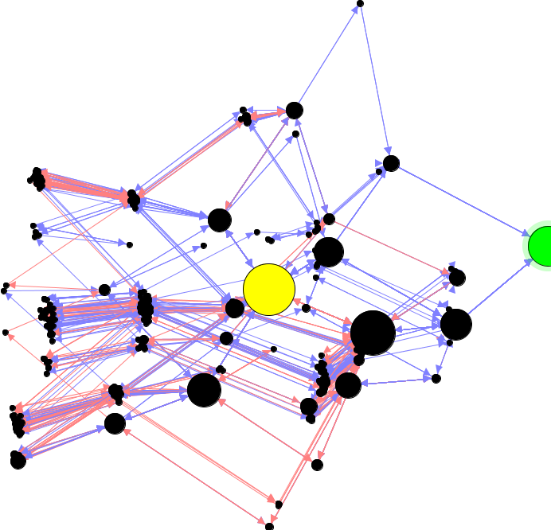
Notes:
We have a built a system that allows us to visualize players based on the moves they make in the game. Here, dots represent game states: the bigger the dot, the more players that reached that state. States are mapped to two dimensions so that similar states are close to each other. Blue arrows represent moves made by winning players, and red arrows are moves made by losing players.
The yellow state is the start and the green state is the end, so players that move left are getting farther from the goal. We can look at this visualization and find clusters to figure out what players are thinking and what strategies they employ.

Slide 48
Notes:
For example, if we look at this state,

Slide 49
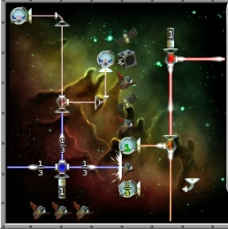
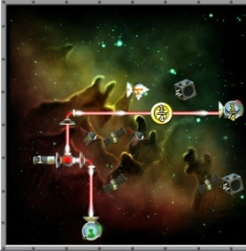
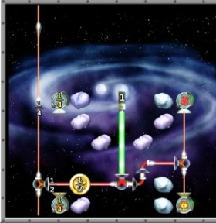
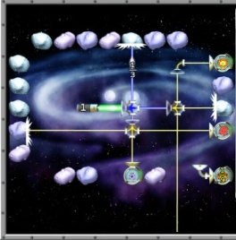
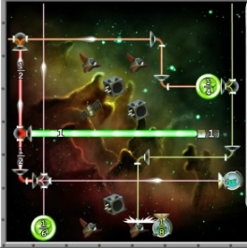
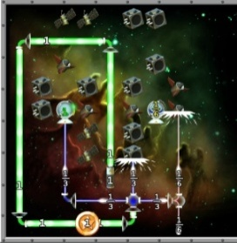
Reinforcement Learning problem
…
?
Goal: Maximize student’s learning & engagement
Notes:
The problem we need to solve is: Given what we know about the student based on their gameplay history (represented by smiley faces), which level should we give them next? The goal is to give out levels that efficiently teach students the relevant concepts, while at the same time keeping them from being bored or frustrated. Both of these are long-term goals, not immediate. The major challenges here are learning over the giant state space, namely all possible histories, and the giant action space, namely all possible level configurations.

Slide 50
Transfer
3-0
1-1a
1-2
2-0
1-0
1-1b
1-2
1-3
1-4
1-5
2-0
3-0
Transfer
Notes:
Here’s an example of how we analyze data from players. This first player does well on the third example of the first concept, and so we move them on to the second and third concepts. But when we test their transfer to other games, the score is very low. So we backpropagate that information through all the states they visited. This allows us to prioritize the long term rewards such as transfer over the short term rewards such as boredom. Now a second player starts the game, but does differently on the first level. We give them the second level and they perform roughly the same. An important challenge in RL is compacting states, or determining when two players histories are similar enough they can share data. This can be done by either designing a well-constructed state space or by learning where the overlap is based on the data. For the sake of argument let’s assume this happens here. We give problem 3 and the player does well, but we decide to explore to stay away from the first player’s path. We give them a few more levels before moving on to the other concepts and they do well. Now again, we backpropogate that info. Note that since the paths crossed, we can fill in info for both paths. It actually turns out that the best path we find for a player who does okay on level 1 is not a path any player played, but rather a combination. This shows the power of reinforcement learning over A/B testing.

Slide 51
1-3
Notes:
Note that in reality the problem may be many times more complex. Using all this information from so many players, our policy gets better and better at teaching people and keeping them engaged. And with so many paths through the space, we’ll be able to know at every state what is the best direction to lead players.

Slide 52
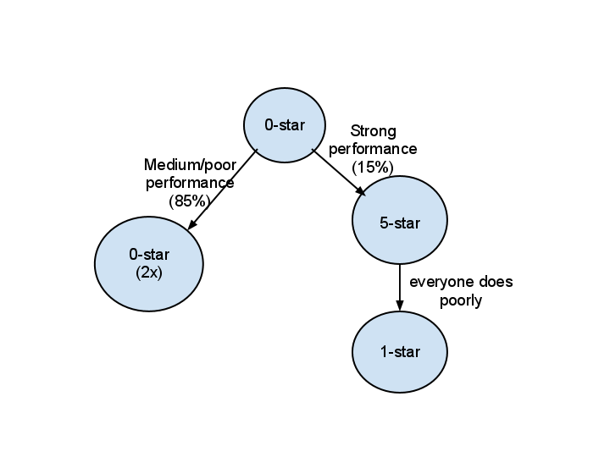
Early Experiment
Notes:
We have performed an initial experiment using some of these ideas on one of our games. We tested the algorithm on a much simpler domain, with the goal being to try to get the players to play the game as long as possible, and the only actions being to give difficulties (from 0-5 stars, 5 being the toughest). Our policy is better than the random baseline. When we tried to compare our policy to the human-designed policy, some of all developers made a mistake asking for demographics, causing the progression to do very badly. So we don’t have results for that yet. However, examining the policies shows the potential of this approach to generate unusual progressions that allow us to better understand human behavior. For example, when picking the first three levels of the game, the game picks the first level to be the easiest. If you don’t do really well, it classifies you as a beginner and keeps you at that difficulty for another 2 levels so as not to frustrate you. However, if you do well on the zero-star, the policy realizes you are at risk of being bored and so gives you the hardest possible level. It does this even though it knows you won’t do that well, because it wants to demonstrate that this game has to potential to be challenging. It then lowers the difficulty back to a normal level.

Slide 53
Key RL experiments
Dwell Time (Time on Task)
A A A B B B AB AB
A B AB C ABC D ABCD
Challenge layering
… ABC D AD BD CD ABD ACD ABCD
… ABC D ABCD E ABCDE
Challenge Ordering
B BC A ABC
AB C ABC F D FD ABCDF

Slide 54
Key RL experiments
Optimal hinting strategies
Persistence and tenacity
Long-term effects on domains
Self-identification

Slide 55
Effects of hinting depth
Two 1/3 Ships:
(1) "Try this piece" <point to the 3-splitter>
(2) "To make 1/3, split the laser in three"
(3) "How much power do the ships need?"
Make 1/4:
(1) "Try using BOTH two-splitters" <point to one two-splitter>
(2) "To make 1/4, split the laser two times"
(3) "None of the pieces split into four. How do you make 1/4?"
Split Ordering:
(1) "Try this piece first" <point to three-splitter>
(2) "Split the laser in thirds first"
(3) "Which splitter should you use first?"

Slide 56
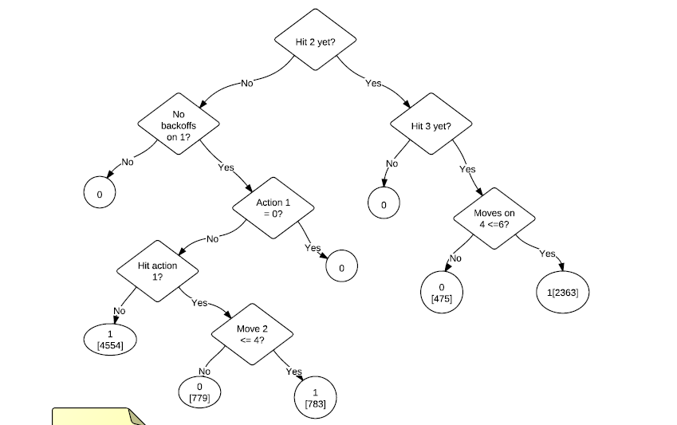
RL Policy

Slide 57
Social elements
Team play
Direct realtime collaboration
Collective inteligence
Team competition
Peer tutoring
Intrinsic Motivation

Slide 58
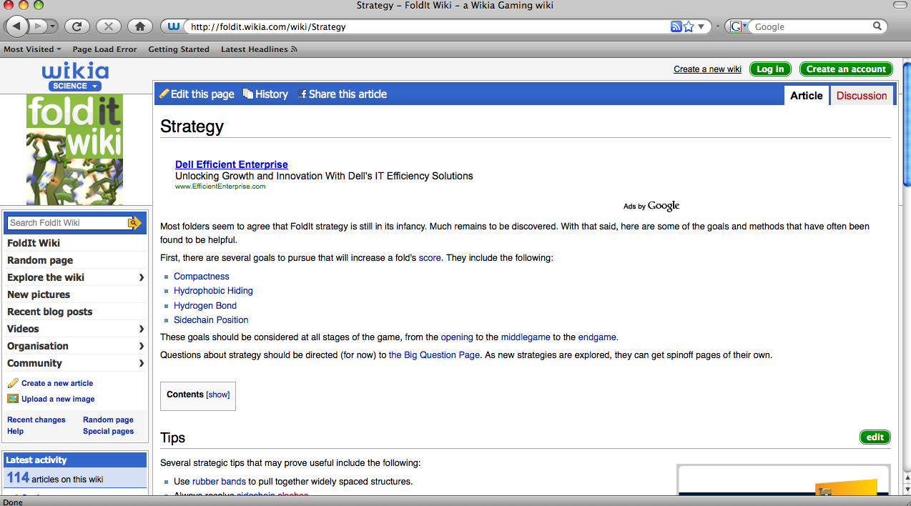
Player Strategy Wiki
Notes:
Player search over strategies; not just searching for solutions
Wiki; create new terminology, share strategies

Slide 59
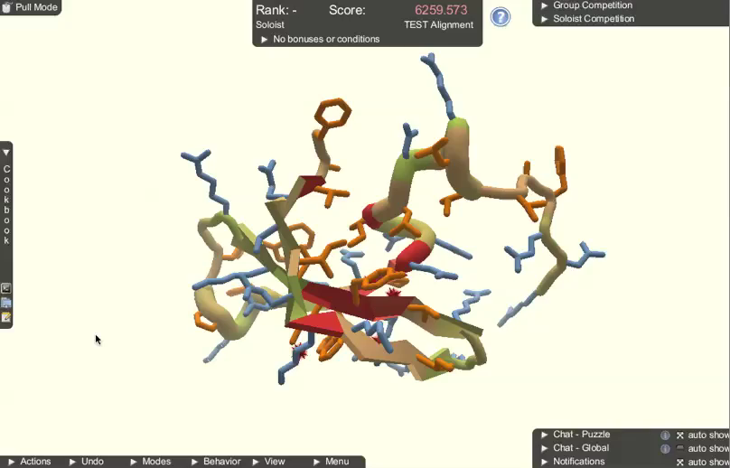
Foldit Cookbook
Notes:
See if players can codify their strategies in a systematic
Gave players a cookbook to code up algortihms
Visual block-based and scripting language
Players can share algorithms online, edit, and run other players’ algorithms

Slide 60
88%
of players run others’ recipes
32%
of players run only
others’ recipes

Slide 61
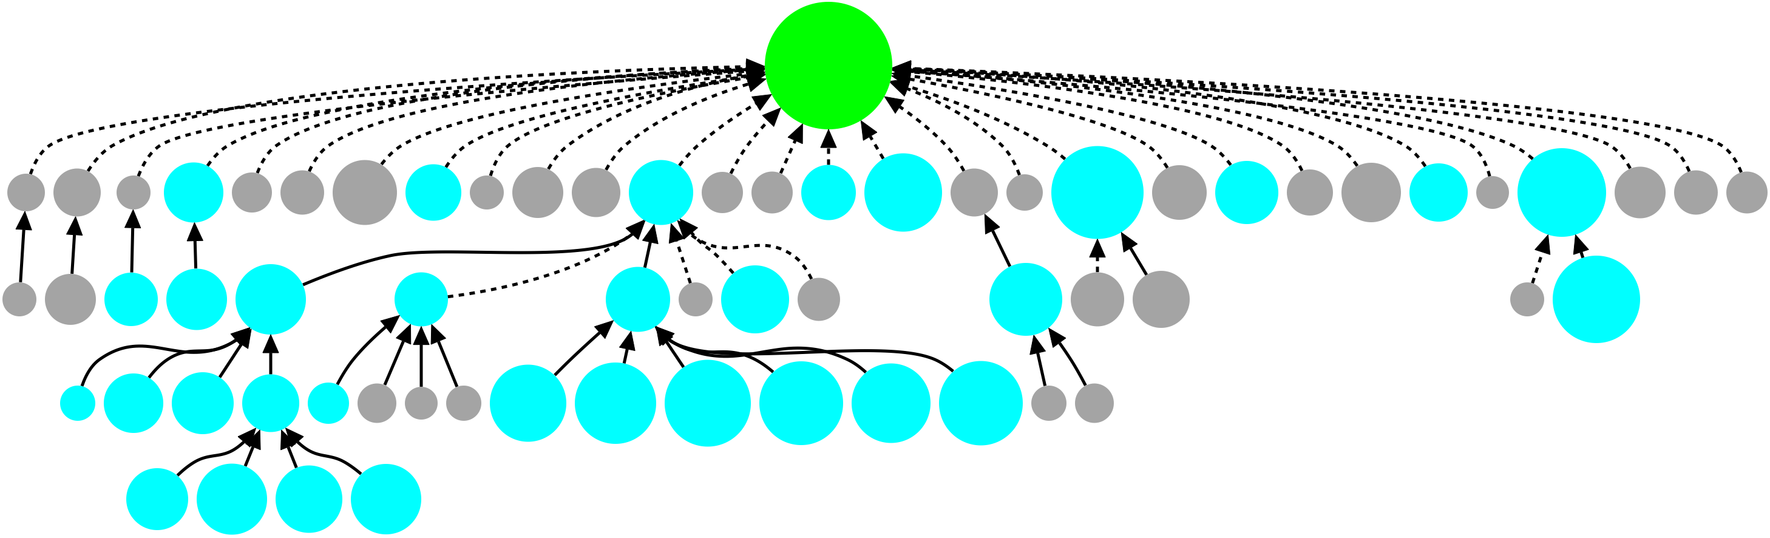
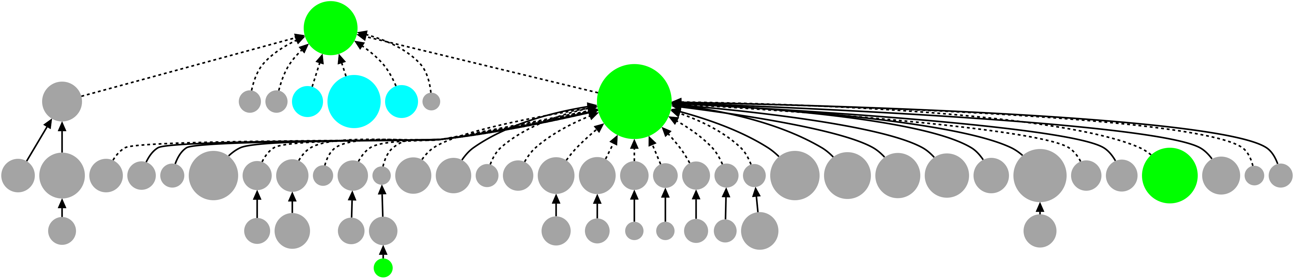
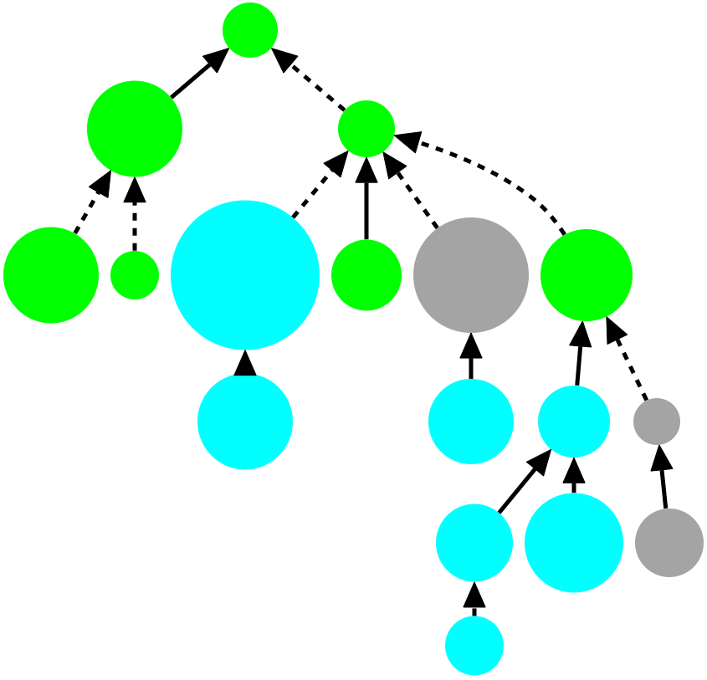
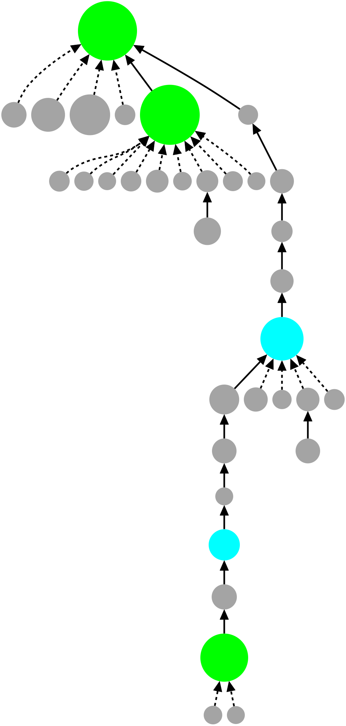
Public shared
Group shared
Private
players are taking and modifying shared recipes

Slide 62
Algorithm Comparison
Player
Algorithm
(Blue Fuse v1.1)
Set FA_REP to 0.05
Shake
Set FA_REP to 1
Wiggle
Set FA_REP to 0.07
Shake
Set FA_REP to 1
Wiggle
Accept Best Energy
Set FA_REP to 0.3
Adjust repulsive force
Wiggle
Set FA_REP to 1
Discrete optimization
Wiggle
Accept Best Energy
Continuous optimization
Notes:
Comparable algorithmically and in performance

Slide 63
Algorithm Comparison
Player
Algorithm
(Blue Fuse v1.1)
Scientist
Algorithm
(Fast Relax)
Set FA_REP to 0.05
Set FA_REP to 0.02
Shake
Repack/Minimize
Set FA_REP to 1
Set FA_REP to 0.25
Wiggle
Repack/Minimize
Set FA_REP to 0.07
Set FA_REP to 0.55
x5-15
Shake
Repack/Minimize
Set FA_REP to 1
Set FA_REP to 1
Wiggle
Repack/Minimize
Accept Best Energy
Set FA_REP to 0.3
Accept Best Energy
Adjust repulsive force
Wiggle
Set FA_REP to 1
Discrete optimization
Wiggle
Accept Best Energy
Continuous optimization
Notes:
Comparable algorithmically and in performance

Slide 64
Algorithm Comparison
Player
Algorithm
(Blue Fuse v1.1)
Scientist
Algorithm
(Fast Relax)
Set FA_REP to 0.05
Set FA_REP to 0.02
Independent discovery of scientists’ algorithmic techniques
Shake
Repack/Minimize
Set FA_REP to 1
Set FA_REP to 0.25
Wiggle
Repack/Minimize
Set FA_REP to 0.07
Set FA_REP to 0.55
x5-15
Shake
Repack/Minimize
Set FA_REP to 1
Set FA_REP to 1
Wiggle
Repack/Minimize
Accept Best Energy
Set FA_REP to 0.3
Accept Best Energy
Adjust repulsive force
Wiggle
Set FA_REP to 1
Discrete optimization
Wiggle
Accept Best Energy
Continuous optimization
Notes:
Comparable algorithmically and in performance

Slide 65
Self Identification

Slide 66
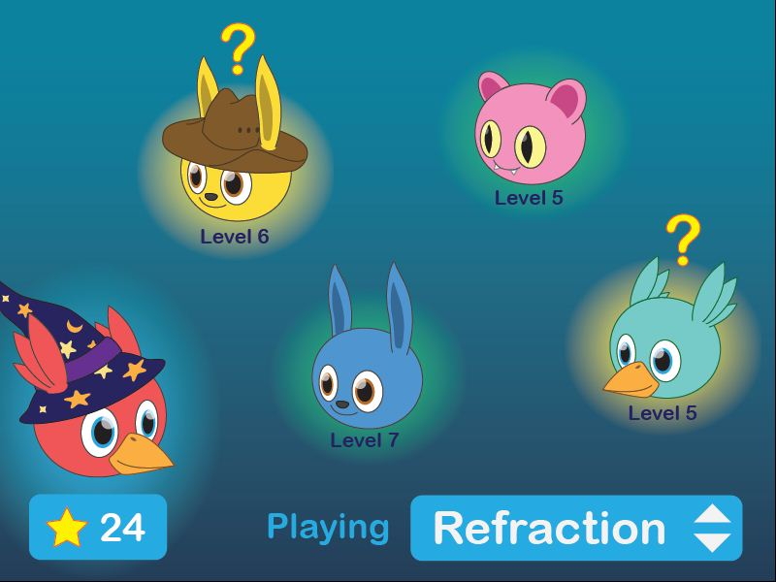

Slide 67
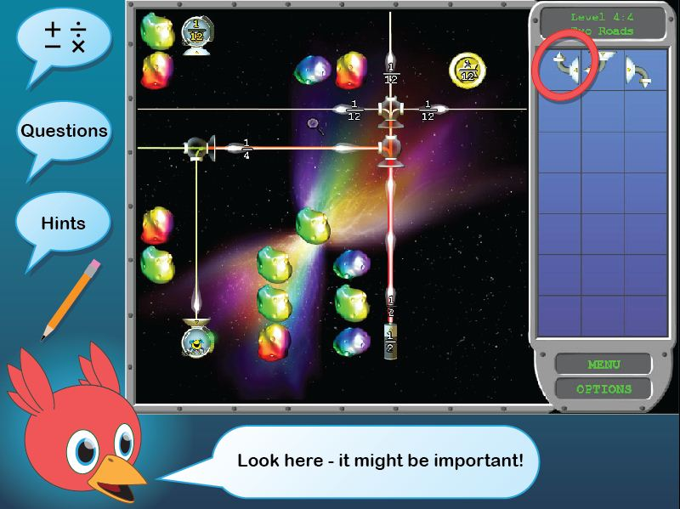

Slide 68
Iterative dual objective optimization
Program plan
develop
int
beta
FCS
Our reality
develop
int
beta
FCS

